Slide 1

CHANDRA X-ray sources classification Using Machine Learning
Shivam Kumaran
IIST , Trivandrum

Slide 2
Outline
What I tried ,
What I learned
Results I got
How I got them
Confusions I have
What I know that I don’t know
Plans to solve them

Slide 3
Contents
Problem Statement
Data source
Methodology
Solution / Results
Challanges

Slide 4
Problem Statement
We need to classify X-ray sources identified in Globular cluster from CHANDRA catalogue (CSC 2.0).

Slide 5
X-ray sources in Globular cluster
Typically X-ray sources found in Globular clusters are
LMXB
CVs
Milli second pulsars
Cheng, Zhongqun, et al. "A Chandra Survey of Milky Way Globular Clusters. I. Emissivity and Abundance of Weak X-Ray Sources." The Astrophysical Journal 858.1 (2018): 33.
Pooley, David. "Globular cluster x-ray sources." Proceedings of the National Academy of Sciences 107.16 (2010): 7164-7167.

Slide 6
Data source
Need training Data for classification
CHANDRA have catalogue of a large collection of x-ray sources
But...class information is not there.
Source other published catalogue for required classes.

Slide 7
Data source
HEASARC X-ray master catalogue
The XRAY master catalog table was last updated on 19 August 2021.
Select require classes
Download entire dataset (name , RA, DEC, Error offset) for the selected class
Cross-correlate with Chandra Source Catalogue
Cross correlation radius issue ,
Chandra resolution 1 arcsec
Res is decided by the two tables , min - 0.17 arcmin

Slide 8
Data
HMXB
Total - 564
LMXB
Total - 431
CVs
Total - 1356

Slide 9
More about Dataset
Position
Source significance
Source extent
Aperture Photometry
Photon flux
Energy flux
Model Fitting
Powerlaw model
Black body
Bremsstrahlung
Apec
Hardness Ratios
Source Variability
Observation Summary
Total Columns : 529
Sparse dataset : 0.52

Slide 10
Methodology
Design a basic classifier network
Classification beteen Major classes for different class combinations
Use this network to study feature importance
Imporove the classifier and try to identify better classifier to work with
To compe up with a multi-class classifier
Total Columns :

Slide 11
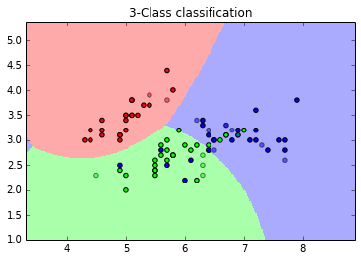
Neural Network for classification
Probabilistic classification : need to assign a posterior probability of to the observation belonging to certain class
Given problem is for classification where given information is input feature vector and output is one of the class

Slide 12
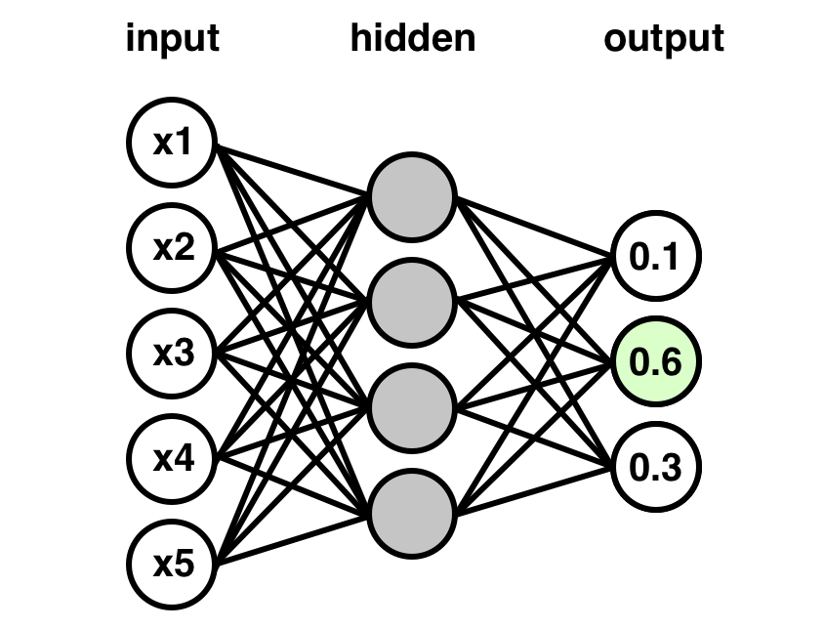
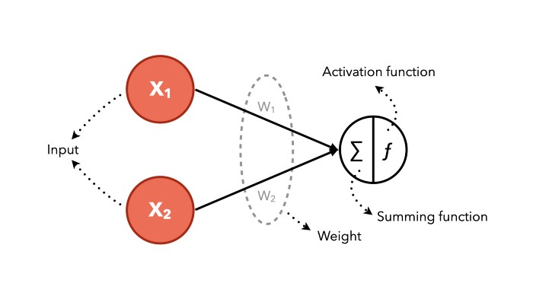
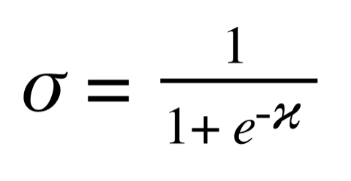
Neural Network for classification
Network
Activation function

Slide 13
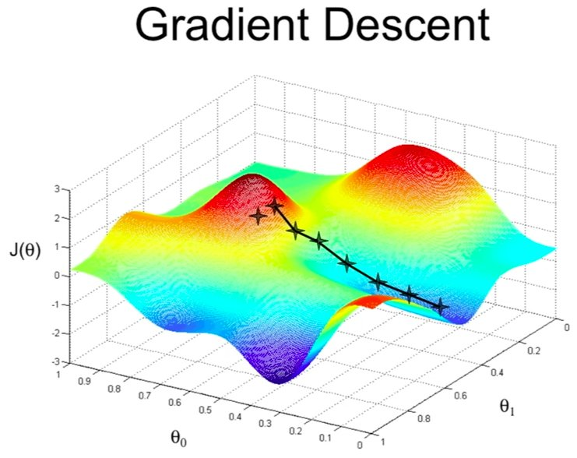
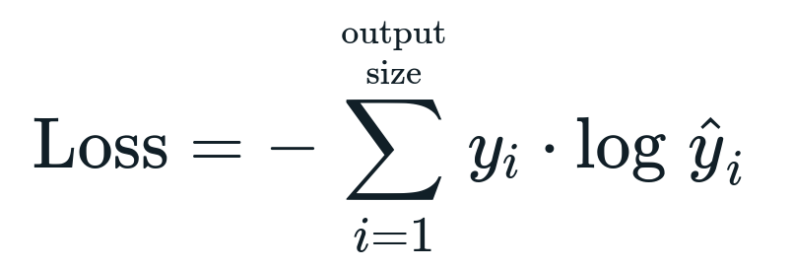
Neural Network for classification
[0.0]
[1.0]
[0.0]
Activation function
Loss function
Optimizer
Stochastic Gradient Descent

Slide 14
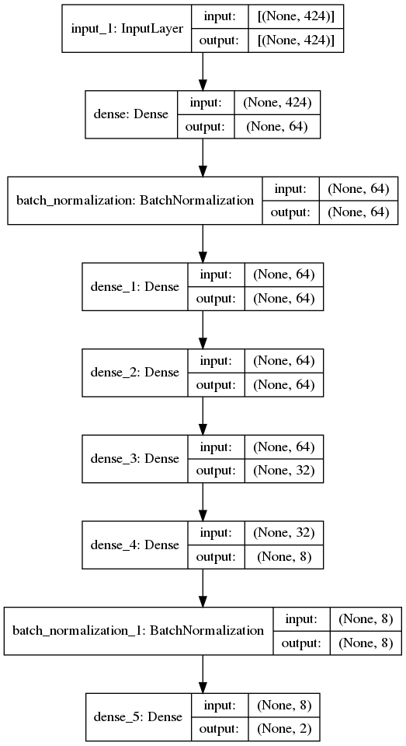
Our Initial NN model
Network Layout
Simple fully connected model
Fine tuning Not done yet
Loss function : Cross- entropy
Optimizer : SGD

Slide 15
Our Initial NN model
Case 01
(q . LMXB + q.HMXB) vs CVs
Data Split
Feature vector size: 424
Total size : 1374
CVs : 943
XRB : 528
Both classes combined and rows reshuffled
Training data : 961
Test data : 413

Slide 16
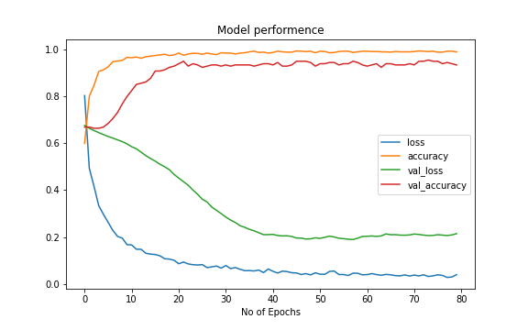
Initial Results all LMXB vs CV
Data Split
Feature vector size: 424
Total size : 1374
CVs : 943
XRB : 431
Both classes combined and rows reshuffled
Training data : 961
Test data : 413
training data prediction
(961, 424)
correct prediction : 940
total prediction : 961
Score 97.81
----------------------------------
test data prediciton
(413, 424)
correct prediction : 395
total prediction : 413
Score 95.64

Slide 17
Feature Importance
Ideas
Using 2 layers NN
Individual scan over entire Feature vector
Scan over FV category wise
Using Principle component analysis

Slide 18
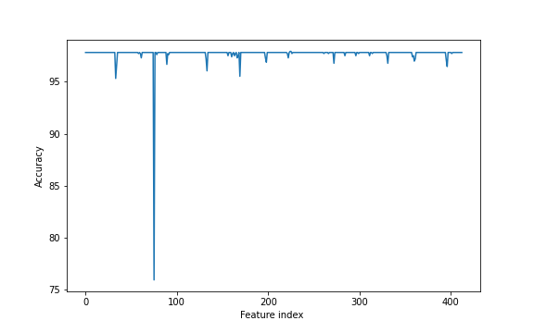
Feature Importance
Scan Over individual Features,
Features with acc-drop more than 0.5%
B_B_KP_INTRA_PROB
B_B_KS_INTRA_PROB
B_BII
B_ERROR_ELLIPSE_ANGLE
B_H_KP_INTRA_PROB
B_H_KS_INTRA_PROB
B_HARDNESS_RATIO_MS_LO
B_M_KS_INTRA_PROB
B_S_KS_INTRA_PROB
B_U_KS_INTRA_PROB
B_VAR_INTER_HARD_PROB_HS
B_VAR_INTER_HARD_PROB_MS
B_W_KP_INTRA_PROB
B_W_KS_INTRA_PROB

Slide 19
Challanges
Sparse data , sparsity : 0.52
Data imbalance
Relying on other catalogue , need to take into account cross-match error
Need to factor pile-up flags

Slide 20
Further Experiments
Classification with different class combinations,
Adding further layer of classification for sub-classes
Finding accurately feature vector importance
Improving accuracy
Try other network models, , Random forest classifier

Slide 21
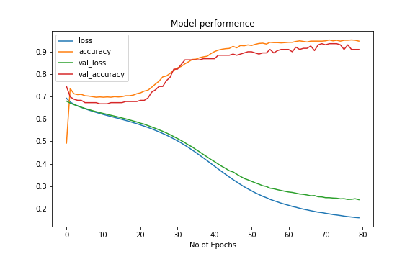
Batch Normalisation layer
WIthout batch normalisation
With batch normalisation

